Slide 1

Department of Computer Engineering
Sequential Logic Design – Sequence generator
1

Slide 2
Points covered
Department of Computer Engineering
Introduction
Sequence generator truth table
2

Slide 3
Department Vision & Mission
Department of Computer Engineering
Vision
Achieve academic excellence through education in computing, to create intellectual manpower to explore professional, higher educational and social opportunities.
Mission
To impart learning by educating students with conceptual knowledge and hands on practices using modern tools, FOSS technologies and competency skills there by igniting the young minds for innovative thinking, professional expertise and research.

Slide 4
Department of Computer Engineering
J K Flip Flop
JK truth table
JK excitation table
J | K | Qn+1
0 | 0 | Qn
0 | 1 | 0
1 | 0 | 1
1 | 1 | Qn’
Qn | Qn+1 | J | K
0 | 0 | 0 | X
0 | 1 | 1 | X
1 | 0 | X | 1
1 | 1 | X | 0

Slide 5
Design & implement Sequence generator using MS JK flip-flop
Department of Computer Engineering
1
3
5
6
7
A circuit which generates a prescribed sequence of bits, in synchronium with a clock, is referred to as a Sequence Generator.

Slide 6
Department of Computer Engineering
Sequence Generators can be used for:
Counters
Random bit generators
Prescribed period and Sequence generator

Slide 7
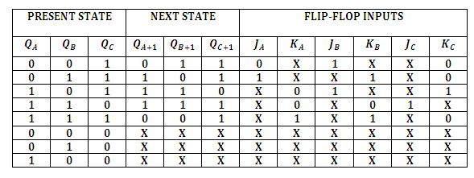
Department of Computer Engineering
1
3
5
6
7

Slide 8
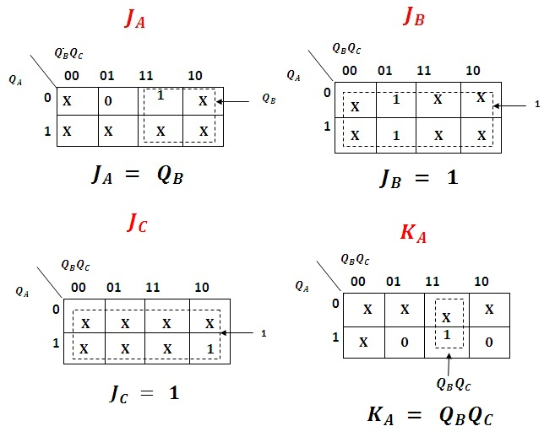
K-Map & Simplification:
Department of Computer Engineering

Slide 9
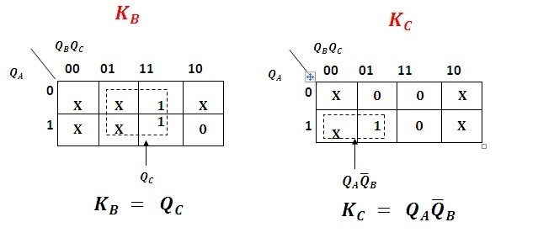
K-Map & Simplification:
Department of Computer Engineering

Slide 10
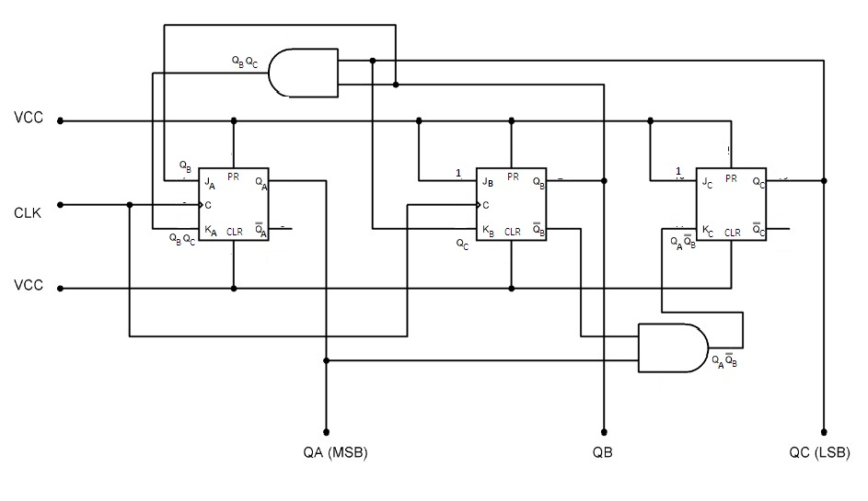
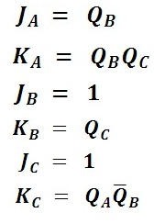
Department of Computer Engineering
Sequence Generator Circuit Diagram
Input Expressions
for Flip-Flop

Slide 11
Department of Computer Engineering
Thank you

